Slide 1

CONTINUOUS SIGN LANGUAGE RECOGNITIONUSING HYBRID TRANSFORMER ARCHITECTURE
Archie Narayan (Roll No: 24A03RES119)
Supervisor : Prajna P.N.

Slide 2
Motivation
Sign language communication still faces a major accessibility gap in real-world settings.
Continuous Sign Language Recognition (CSLR) is harder than isolated signs due to unclear sign boundaries and long temporal context.
Project goal: build a practical pipeline for `video -> gloss text`and ‘text -> video’, with a bidirectional demo.

Slide 3
Dataset
RWTH-PHOENIX-Weather 2014 T (standard CSLR benchmark).
( https://www-i6.informatik.rwth-aachen.de/~koller/RWTH-PHOENIX-2014-T )

Slide 4
Architecture

Slide 5
Input video frames are encoded by a pretrained ResNet-18 visual backbone.
A Transformer encoder captures temporal dependencies across frame features.
Two decoding paths are used jointly: CTC head and attention decoder.
Output is gloss sequence as german text.

Slide 6
Why Hybrid?
Pure CTC can become blank-heavy in difficult continuous sequences.
Attention decoder captures token dependencies and improves sequence coherence.
Hybrid loss balances both strengths: CTC for alignment, attention for contextual decoding.
In this implementation, hybrid setup was more reliable than pure CTC behaviour.

Slide 7
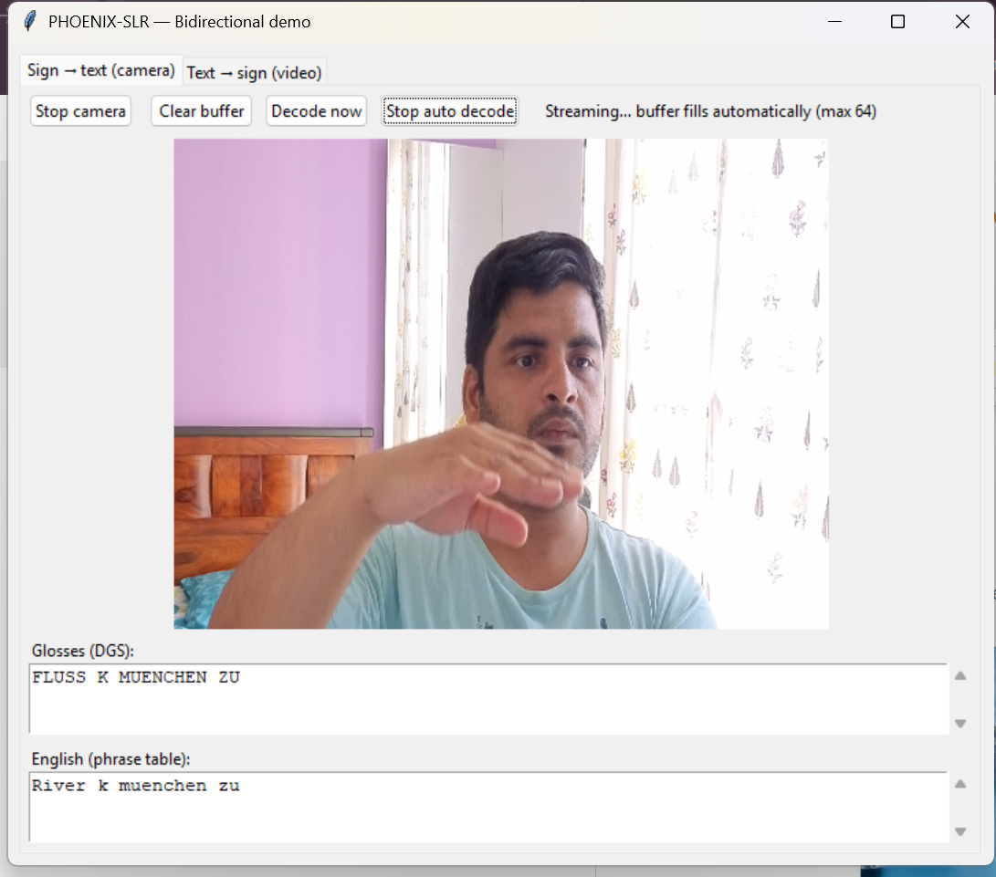
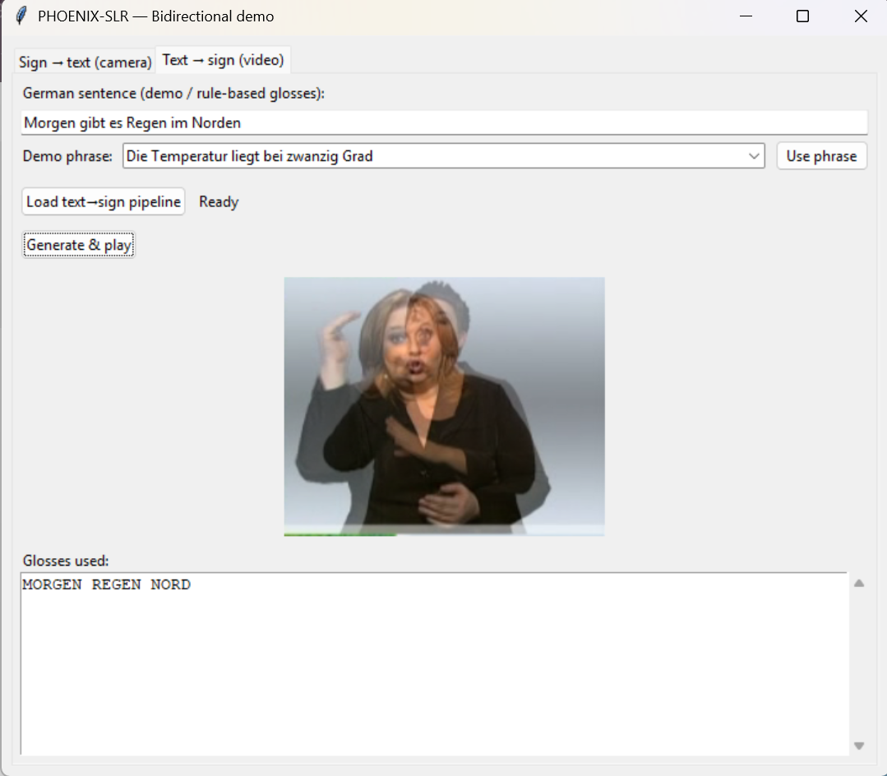
Demo Screenshots

Slide 8
Limitations
test WER ~50.9%
weather-domain data
signer/style variation
retrieval-based text-to-sign is not full generative signing

Slide 9
Conclusion and Future Scope
Implemented a complete CSLR pipeline and integrated a usable bidirectional prototype.
Hybrid CTC+Attention improved practical robustness compared to pure CTC path.
Future work: stronger pretraining, signer adaptation, language-model support, and generative text-to-sign generation.

Slide 10
Thank you!

